Slide 1
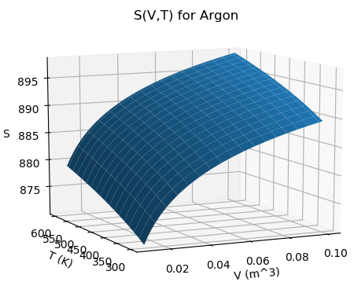
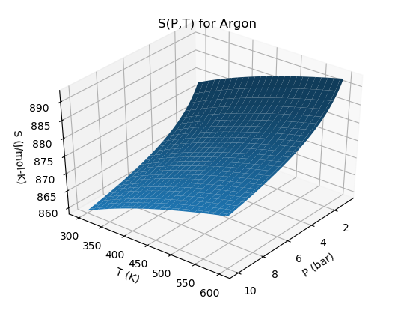
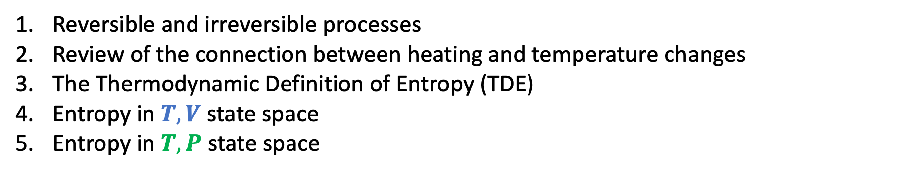
Agenda for today: Entropy
Reversible and irreversible processes
Review of the connection between heating and temperature changes
The Thermodynamic Definition of Entropy (TDE)
Entropy in $T,V$ state space
Entropy in $T,P$ state space

Slide 2
Reversibility
What’s a reversible process? We like to talk about three kinds of reversibility, actually:
We say a process is thermally reversible when there is not a big temperature difference between a system of interest and its surroundings.
We say a process is mechanically reversible when there’s not a big pressure difference between a system of interest and its surroundings.
We say a process is chemically reversible when a system is close to chemical equilibrium.
Some examples …
In a glass of ice water, a little ice melts
You add some instant coffee to water
A balloon pops

Slide 3

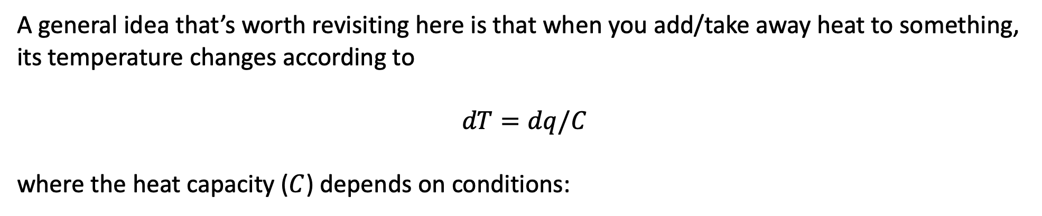
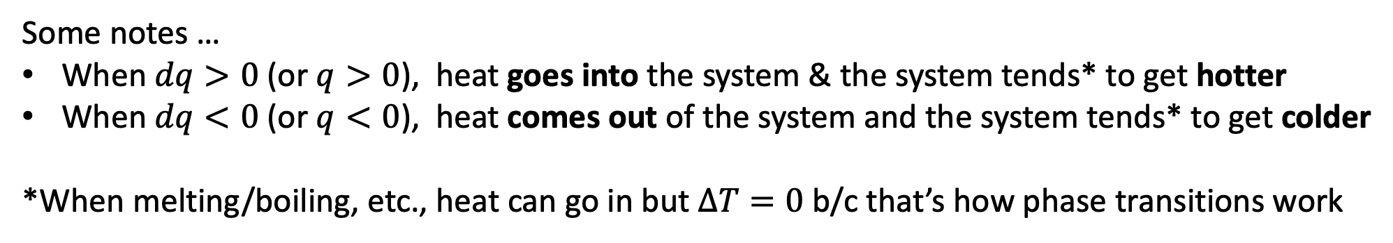

Heating, changes in temperature, and heat capacity
A general idea that’s worth revisiting here is that when you add/take away heat to something, its temperature changes according to
$$dT=dq/C$$
where the heat capacity ($C$) depends on conditions:
Constant-volume heating
$$dT=dq/C_{V}$$
Constant-pressure heating
$$dT=dq/C_{P}$$
Some notes …
When $dq>0$ (or $q>0$), heat goes into the system & the system tends* to get hotter
When $dq<0$ (or $q<0$), heat comes out of the system and the system tends* to get colder
*When melting/boiling, etc., heat can go in but $∆T=0$ b/c that’s how phase transitions work

Slide 4
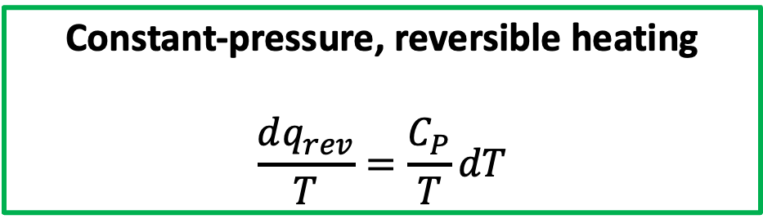
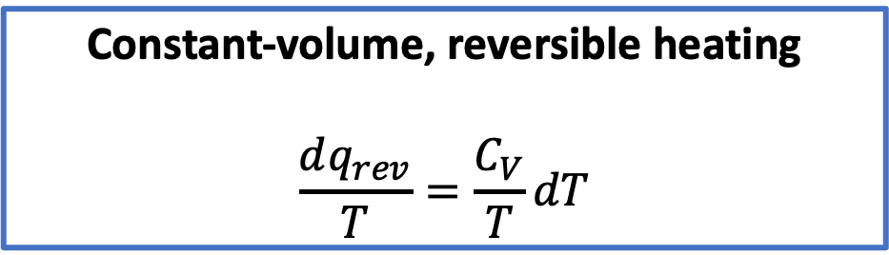
Combining these ideas (and doing a little algebra)
Constant-volume, reversible heating
$$\frac{dq_{rev}}{T}=\frac{C_{V}}{T}dT$$
Constant-pressure, reversible heating
$$\frac{dq_{rev}}{T}=\frac{C_{P}}{T}dT$$

Slide 5
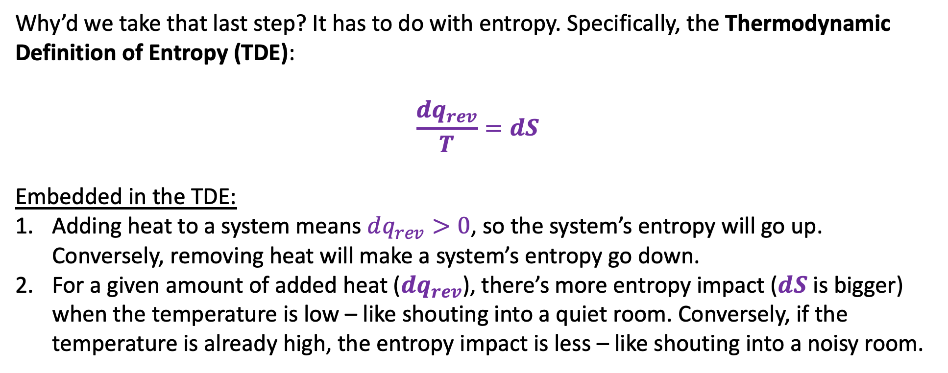
The Thermodynamic Definition of Entropy relates heat input/output to a change in entropy
Why’d we take that last step? It has to do with entropy. Specifically, the Thermodynamic Definition of Entropy (TDE):
$$\frac{dq_{rev}}{T}=dS$$
Embedded in the TDE:
Adding heat to a system means $dq_{rev}>0$, so the system’s entropy will go up. Conversely, removing heat will make a system’s entropy go down.
For a given amount of added heat ($dq_{rev}$), there’s more entropy impact ($dS$ is bigger) when the temperature is low – like shouting into a quiet room. Conversely, if the temperature is already high, the entropy impact is less – like shouting into a noisy room.

Slide 6
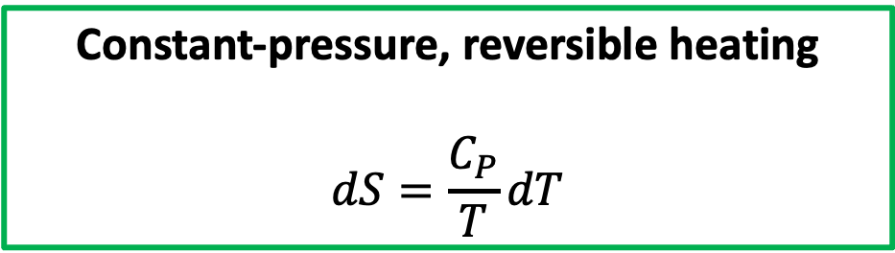
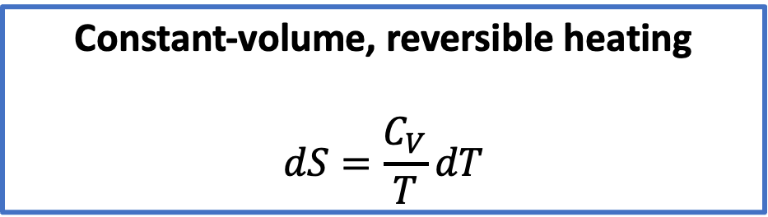

This lets us find the change in entropy from a temperature change
Since TDE says $dS=\frac{dq_{rev}}{T}$, we have
Constant-volume, reversible heating
$$dS=\frac{C_{V}}{T}dT$$
Constant-pressure, reversible heating
$$dS=\frac{C_{P}}{T}dT$$
Our next task is to integrate these ideas into the notion of thermodynamic surfaces. We’ll start with $S(T,V)$

Slide 7
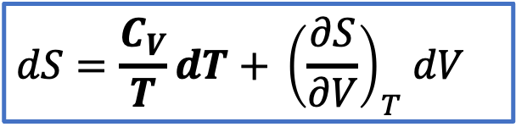
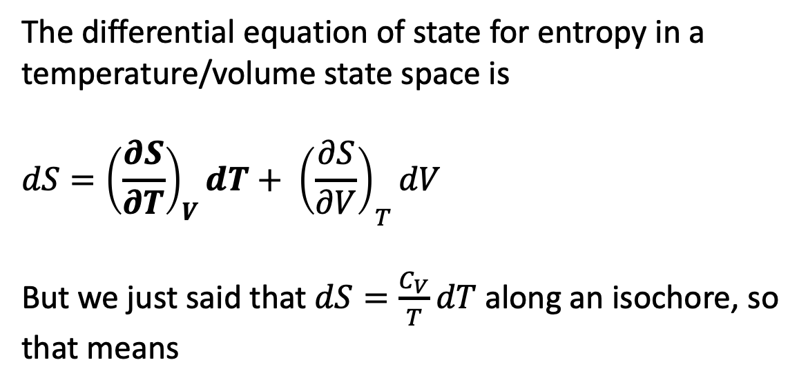


$S(T,V)$ and its differential equation of state
The differential equation of state for entropy in a temperature/volume state space is
$$dS={{\left(\frac{∂S}{∂T}\right)}_{V}dT+ \left(\frac{∂S}{∂V}\right)}_{T}dV$$
But we just said that $dS=\frac{C_{V}}{T}dT$ along an isochore, so that means
$S(T,V)$
$${\left(\frac{∂S}{∂T}\right)}_{V}$$
$${\left(\frac{∂S}{∂V}\right)}_{T}$$
$$dS=\frac{C_{V}}{T}dT{+ \left(\frac{∂S}{∂V}\right)}_{T}dV$$

Slide 8
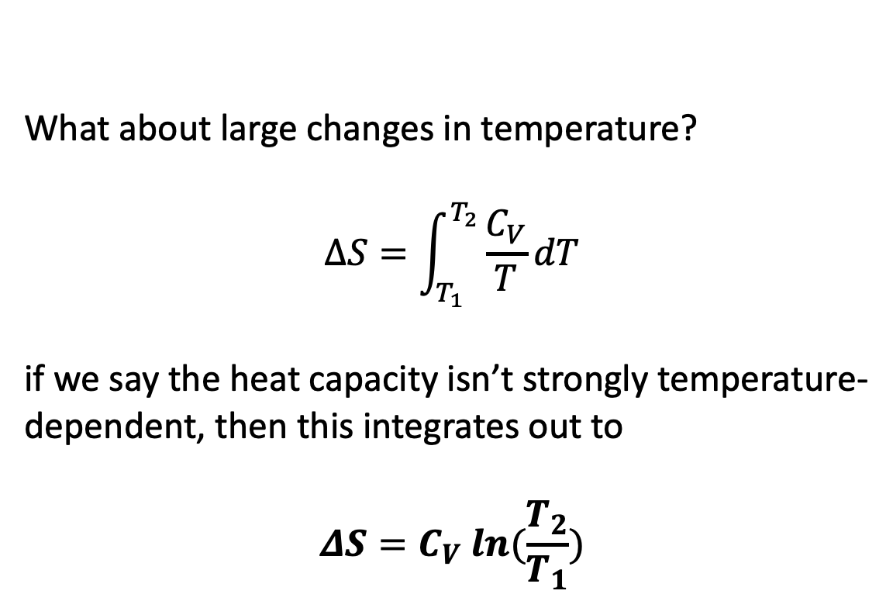


$S(T,V)$ and its differential equation of state
What about large changes in temperature?
$$∆S=\int_{T_{1}}^{T_{2}}{\frac{C_{V}}{T}dT}$$
if we say the heat capacity isn’t strongly temperature-dependent, then this integrates out to
$$ΔS=C_{V} ln⁡(\frac{T_{2}}{T_{1}})$$
$S(T,V)$
$${\left(\frac{∂S}{∂T}\right)}_{V}$$
$${\left(\frac{∂S}{∂V}\right)}_{T}$$
$$dS=\frac{C_{V}}{T}dT{+ \left(\frac{∂S}{∂V}\right)}_{T}dV$$

Slide 9
$S(T,V)$ and its differential equation of state
What about large changes in temperature?
$$∆S=\int_{T_{1}}^{T_{2}}{\frac{C_{V}}{T}dT}$$
if we say the heat capacity isn’t strongly temperature-dependent, then this integrates out to
$$ΔS=C_{V} ln⁡(\frac{T_{2}}{T_{1}})$$
$S(T,V)$
$${\left(\frac{∂S}{∂T}\right)}_{V}$$
$${\left(\frac{∂S}{∂V}\right)}_{T}$$
$$dS=\frac{C_{V}}{T}dT{+ \left(\frac{∂S}{∂V}\right)}_{T}dV$$
You should probably commit this to memory

Slide 10
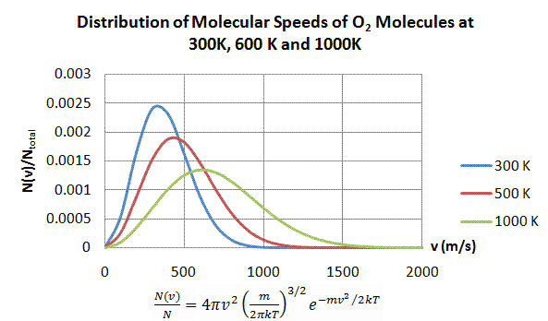
Entropy and thermal choice
These speeds are unavailable at 500 K

Slide 11
How higher temperatures lead to more thermal choice in energy => more entropy
But available at 1000 K

Slide 12
How higher temperatures lead to more thermal choice in energy => more entropy
But available at 1000 K
“Higher temperature increases a systems entropy because molecules have more choice about the energies they can have.”

Slide 13
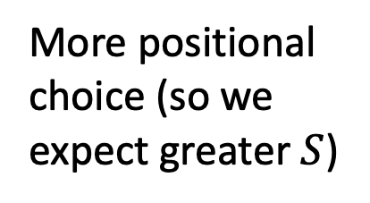
Now we’re going to switch to isothermal expansion (qualitative arguments)
This is isothermal expansion
More positional choice (so we expect greater $S$)

Slide 14
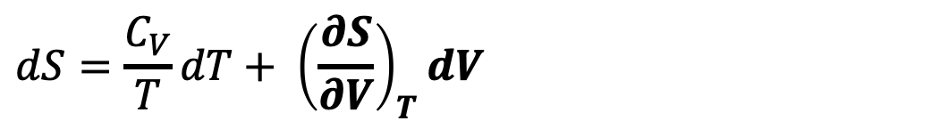
Now we’re going to switch to isothermal expansion (quantitative arguments)
This is isothermal expansion
More positional choice (so we expect greater $S$)
$$dS={\frac{C_{V}}{T}dT+ \left(\frac{∂S}{∂V}\right)}_{T}dV$$

Slide 15
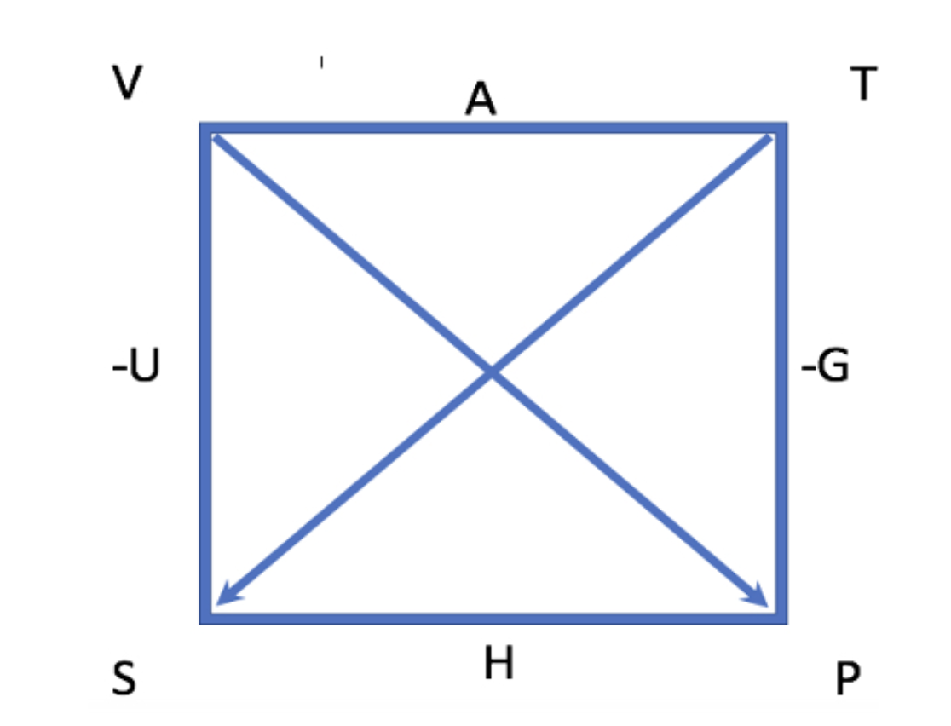
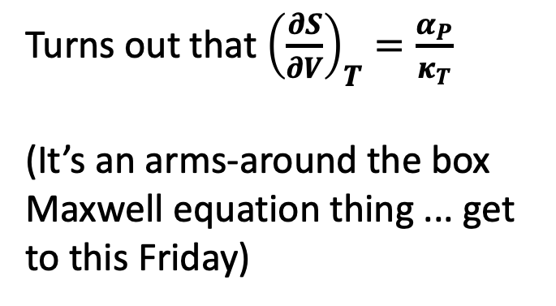
Now we’re going to switch to isothermal expansion (quantitative arguments)
This is isothermal expansion
More positional choice (so we expect greater $S$)
$$dS={\frac{C_{V}}{T}dT+ \left(\frac{∂S}{∂V}\right)}_{T}dV$$
Turns out that ${\left(\frac{∂S}{∂V}\right)}_{T}=\frac{α_{P}}{κ_{T}}$
(It’s an arms-around the box Maxwell equation thing ... get to this Friday)

Slide 16
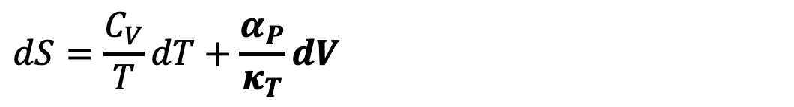
Now we’re going to switch to isothermal expansion (quantitative arguments)
This is isothermal expansion
More positional choice (so we expect greater $S$)
$$dS=\frac{C_{V}}{T}dT+\frac{α_{P}}{κ_{T}}dV$$
General Thermodynamics

Slide 17
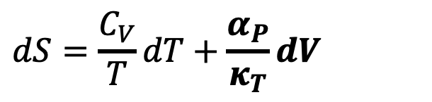
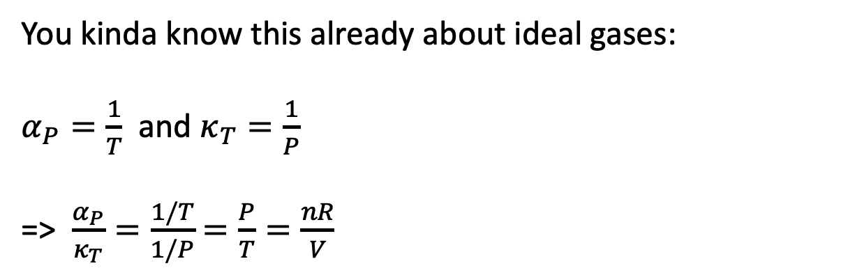
Special Thermodynamics: isothermal expansion of an ideal gas
This is isothermal expansion
More positional choice
You kinda know this already about ideal gases:
$α_{P}=\frac{1}{T}$ and $κ_{T}=\frac{1}{P}$
=> $\frac{α_{P}}{κ_{T}}=\frac{1/T}{1/P}$ $=\frac{P}{T}=\frac{nR}{V}$
$$dS=\frac{C_{V}}{T}dT+\frac{α_{P}}{κ_{T}}dV$$
General Thermodynamics

Slide 18
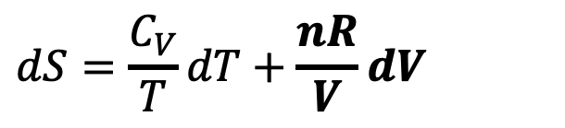
Special Thermodynamics: isothermal expansion of an ideal gas
This is isothermal expansion
More positional choice
You kinda know this already about ideal gases:
$α_{P}=\frac{1}{T}$ and $κ_{T}=\frac{1}{P}$
=> $\frac{α_{P}}{κ_{T}}=\frac{1/T}{1/P}$ $=\frac{P}{T}=\frac{nR}{V}$
$$dS=\frac{C_{V}}{T}dT+\frac{nR}{V}dV$$
Special Thermodynamics (ideal gas)

Slide 19
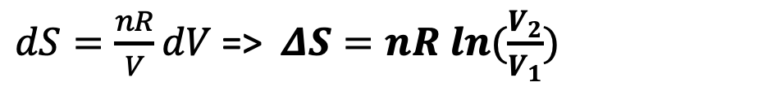
Special Thermodynamics: isothermal expansion of an ideal gas, integrated form
This is isothermal expansion
More positional choice
$$dS=\frac{C_{V}}{T}dT+\frac{nR}{V}dV$$
$dS=\frac{nR}{V}dV$ => $ΔS=nR ln⁡(\frac{V_{2}}{V_{1}})$
Special Thermodynamics (ideal gas)
You should probably commit this to memory

Slide 20
A sample calculation
2x more positional choice
$ΔS=nR ln⁡(\frac{V_{2}}{V_{1}})$ (for an ideal gas)
Say we double the size of a box containing 1 mole of gas.
Answer: $ΔS=R ln\left(\frac{2}{1}\right)=+5.8\frac{J}{mol∙K}$.

Slide 21
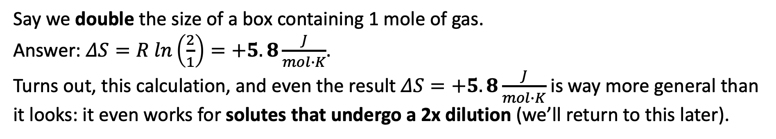
An unexpected generalization: this also works with solutes (?!?!)
2x more positional choice
$ΔS=nR ln⁡(\frac{V_{2}}{V_{1}})$ (for an ideal gas)
Say we double the size of a box containing 1 mole of gas.
Answer: $ΔS=R ln\left(\frac{2}{1}\right)=+5.8\frac{J}{mol∙K}$.
Turns out, this calculation, and even the result $ΔS=+5.8\frac{J}{mol∙K}$is way more general than it looks: it even works for solutes that undergo a 2x dilution (we’ll return to this later).

Slide 22


Summary of $S(T,V)$
$${\left(\frac{∂S}{∂T}\right)}_{V}$$
$${\left(\frac{∂S}{∂V}\right)}_{T}$$
Temperature:
Entropy increases with temperature because of more energy choice
If heat capacity is constant, the increase is logarithmic with respect to temperature
Volume:
Entropy increases with volume because of more positional choice
If it’s an ideal gas, the increase is logarithmic with respect to volume
The positional idea will extend to solutes undergoing dilution (and other phenomena)

Slide 23
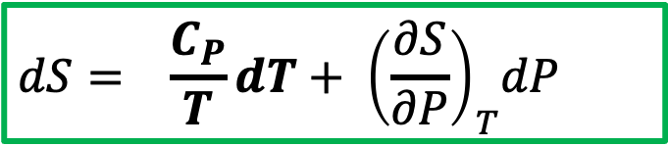
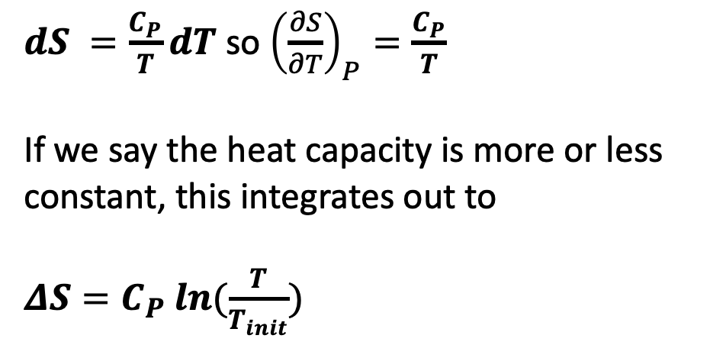


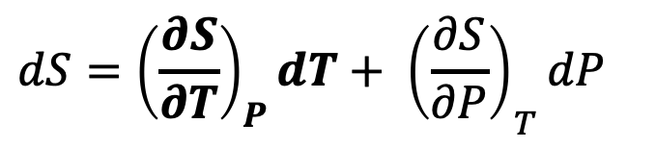
Now switching to $S(T,P)$: isobaric heating
$dS =\frac{C_{P}}{T}dT$ so ${\left(\frac{∂S}{∂T}\right)}_{P}=\frac{C_{P}}{T}$
If we say the heat capacity is more or less constant, this integrates out to
$ΔS=C_{P} ln⁡(\frac{T}{T_{init}})$
$${\left(\frac{∂S}{∂P}\right)}_{T}$$
$${\left(\frac{∂S}{∂T}\right)}_{P}$$
$$dS={{\left(\frac{∂S}{∂T}\right)}_{P}dT+ \left(\frac{∂S}{∂P}\right)}_{T}dP$$
You should probably commit this to memory too
$$dS={ \frac{C_{P}}{T}dT+ \left(\frac{∂S}{∂P}\right)}_{T}dP$$

Slide 24
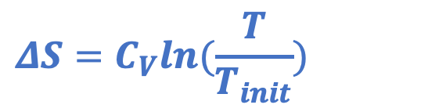
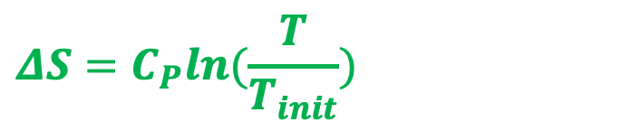
Why isobaric heating increases entropy more than isochoric heating
Isobaric heating
$$ΔS=C_{P}ln⁡(\frac{T}{T_{init}})$$
isobaric
Heating at constant pressure => more in thermal and positional entropy
S
$$ΔS=C_{V}ln⁡(\frac{T}{T_{init}})$$
isochoric
Isochoric heating
T
Heating at constant volume, so increase in thermal entropy only

Slide 25
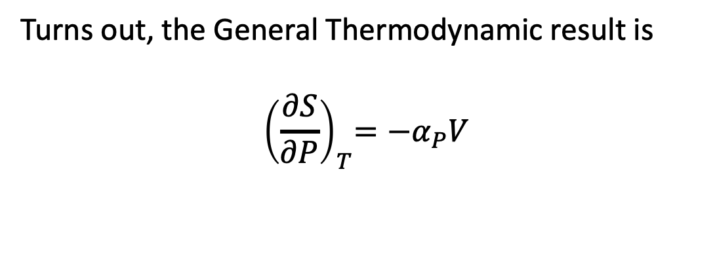
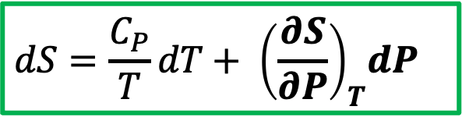
The other dimension of $S(T,P)$: isothermal changes in pressure
Turns out, the General Thermodynamic result is
$${ \left(\frac{∂S}{∂P}\right)}_{T}=−α_{P}V$$
$${\left(\frac{∂S}{∂P}\right)}_{T}$$
$${\left(\frac{∂S}{∂T}\right)}_{P}$$
(Also an arms-around the box Maxwell equation thing ... get to this Friday)
$$dS=\frac{C_{P}}{T}dT+{ \left(\frac{∂S}{∂P}\right)}_{T}dP$$

Slide 26
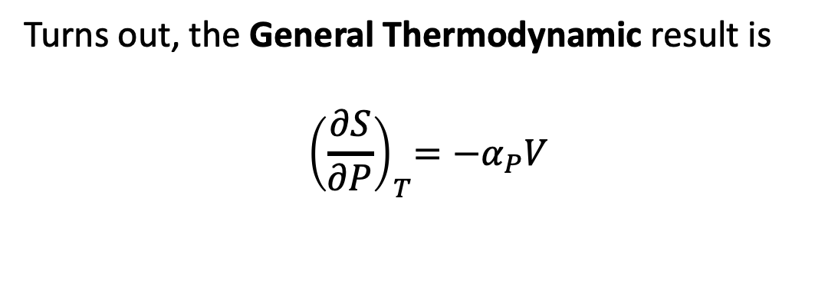
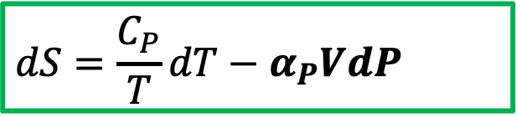
The other dimension of $S(T,P)$: isothermal changes in pressure
Turns out, the General Thermodynamic result is
$${ \left(\frac{∂S}{∂P}\right)}_{T}=−α_{P}V$$
$${\left(\frac{∂S}{∂P}\right)}_{T}$$
$${\left(\frac{∂S}{∂T}\right)}_{P}$$
$$dS=\frac{C_{P}}{T}dT−α_{P}VdP$$
General Thermodynamics

